Slide 1
Architecture
16-bit ALU
A set of 16-bit registers
Segmented memory addressing capability
A rich instruction set
Powerful interrupt structure
Fetched instruction queue for overlapped fetching and instruction execution

Slide 2
Architecture
BIU - Bus interface unit
EU - Execution unit
BIU - circuit for physical address calculations, predecoding instruction byte queue
System bus signals are made available for external interfacing of devices
Responsible for establishing communications with external devices and peripherals including memory via the bus
From segment and offset registers (16-bit long), the physical or effective address is calculated which is 20-bit long

Slide 3
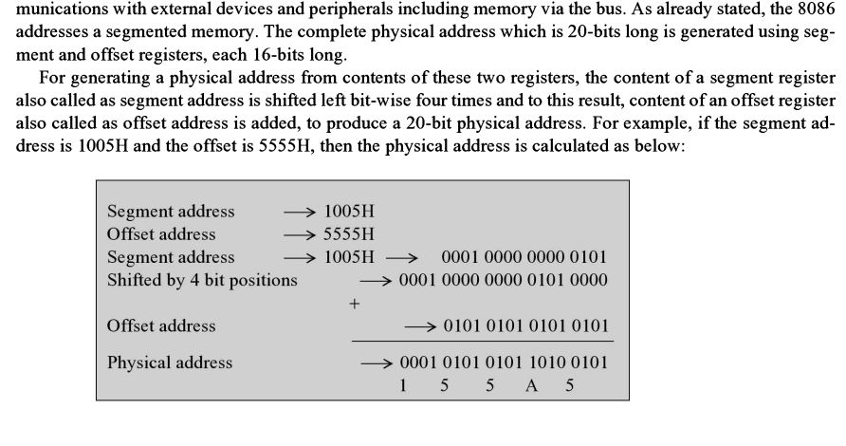

Slide 4
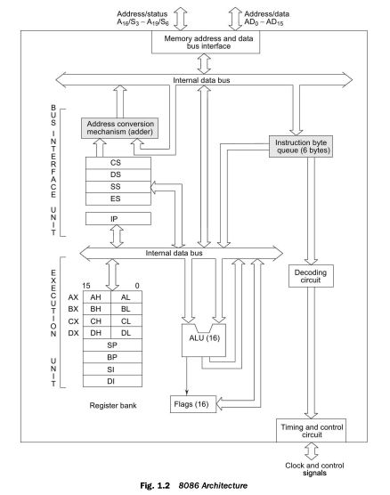

Slide 5
each segment can have maximum of 64K locations
Segment value - 1005 H
Offset values can range from 0000 H to FFFF H
Segment register - base address of the segment (CS, DS, ES, SS)
Offset register - In a segment, the distance of the required memory location from the base address (IP, BP, BX, SI, DI, SP, or an immediate 16 bit value)
Overlapped fetch and execution cycyles

Slide 6
Predecoded Instrcution byte queue ( 6 bytes long)
While the fetched instruction is executed internally the external bus is used to fetch the machine code of the next instruction and place it in queue
Concurrently, Opcode is fetched by BIU, EU executes the previously decoded instruction
BIU + EU forms a pipeline
EU has register set of 8086 except segment register and IP
16-bit ALU to perform arithmetic and logical operations
16-bit flag register shows the results of execution by ALU
Decoding unit decodes the opcode bytes issued by the Instruction byte queue
Timing and control unit derives the control signals to execute the instruction opcode from queue
EU may pass the results back to BIU for storing the results in memory

